Slide 1
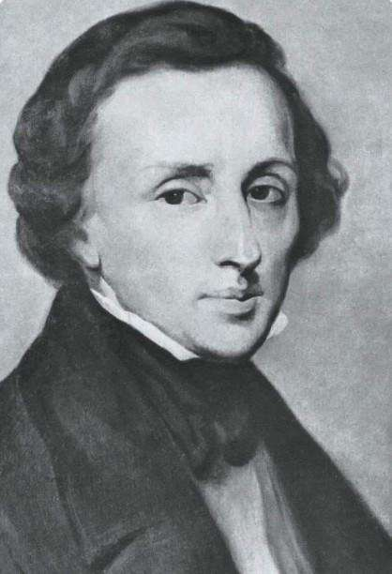

榜
样
EDUCATION MODEL

